Slide 1
AI-Powered Student Grading & Teacher Guidance Automation System
25-26J-162

Slide 2




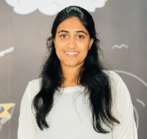

Our Team
Supervisor
Prof. Samantha Rajapaksha
Head | Department of Information Technology
Co-Supervisor
Ms. Bhagyani Chathurika
Academic Coordinator (Matara) | Senior Lecture
Ushan
Malshan
Ridmi
Lashini

Slide 3

Introduction
Information and Communication Technology (ICT) is an important subject in the Sri Lankan G.C.E. O/L syllabus. Many students find it difficult to understand programming logic, databases, networking, and theory-based ICT topics. Teachers also face problems with manual marking, finding student weaknesses, and preparing balanced question papers. To solve these problems, this research introduces an AI-based Learning Management System that helps teachers and students through automated marking, smart analysis, and personalized learning support.

Slide 4

Research Problems
Manual Grading Inefficiency
Teachers spend significant time manually evaluating answer sheets, which delays feedback and increases workload.
Lack of Personalized Learning Support
Students receive the same teaching approach regardless of their individual strengths and weaknesses.
Difficulty in Identifying Concept-Level Learning Gaps
Teachers often struggle to analyze student performance deeply enough to identify specific conceptual weaknesses.
Time-Consuming Question Paper Preparation
Creating balanced question papers aligned with Bloom’s Taxonomy requires considerable effort from teachers.
Limited Student Performance Analytics
Existing systems provide only basic marks without advanced insights into learning progress or knowledge mastery.

Slide 5

Proposed Solution : AI-powered Learning Management System
AI Based Paper creation according to the Blooms Taxonomy theorem.
OCR Module & AI Grading.
Teacher Reteaching Automation System According to the Student Weakness'
AI Based Personalized Learning Plan generating for students.
Easy identification of Student weaknesses for Evaluate.

Slide 6
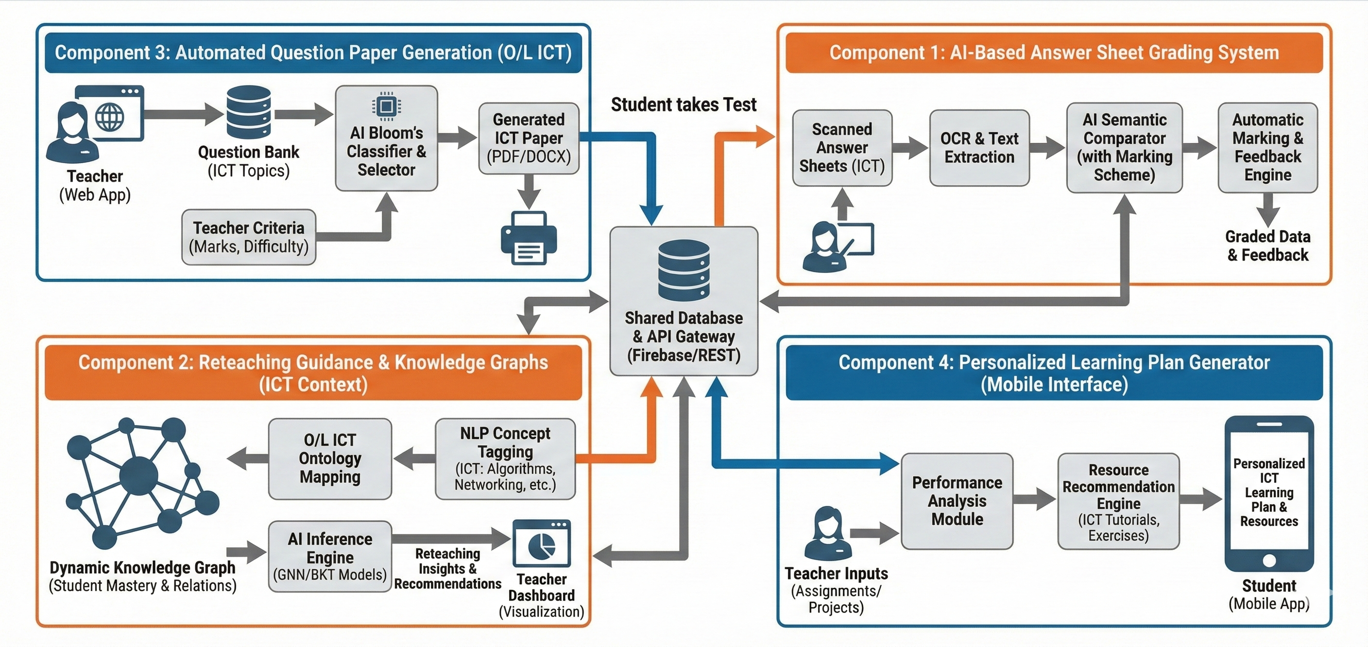
Overall System Architecture Diagram

Slide 7
PP2 Comments & Action Taken
Member | PP2 Comments | Action Taken
All Member | Validate the results from a expert
IT22103154 | Have used a Hybrid model with 3 models
IT22243362 | Better to upload a excel, rather addding MCQs one by one, seems impractical | Upload Exam Paper and generate marking scheme automatically
 | Need to check with the models being used, VLSM which is used seems incompatible, check with another possible model | Tesseract fails on handwriting. Qwen2-VL understands context, handling messy handwriting and ambiguous characters much better. And teacher can upload images better usage in the VLM model

Slide 8
PP2 Comments & Action Taken
Member | PP2 Comments | Action Taken
IT22095480 | Check the validation through the system itself, rather validating through a parent,Currently no accuracy, needs to work on that aspect
IT22120052 | Have a comparison about the models
 | Code comprehension is low

Slide 9


Commercialization
Mr. Dilanka Sanjaya – CEO of Fonix Edu Pvt. Ltd by Atlas Axilla
Name : Mr. Dilanka Sanjaya
Comapany : Fonix Edu Pvt. Ltd
Contact No : 077 050 8710
Email : contact@fonixedu.com
Voice Clip
25-26J-162

Slide 10


Commercialization
Mr. Kaveen Abeysinghe – English Medium ICT Teacher Grade 10/11
Name : Kaveen Abeysinghe
Education : B.ET(Hons) university of Sri Jayewardenepura
Average student count in the pre class : 50
No class : 10
Contact No : 0768906563
Email : kaveenabeysinghe@gmail.com
Voice Clip
25-26J-162

Slide 11

IT22243362
PATHIRAJA P.U.M
OCR Module and AI Grading
BSc. (Hons) in Information Technology Specialization in Information Technology
IT22243363 | Pathiraja P.U.M | 25-26J-162

Slide 12
Overall OCR and Grading Flow
Teacher Uploads Scanned Answer Sheets
Image Preprocessing (Noise Removal, Binarization, Skew Correction)
OCR Text Extraction from Handwritten Answers
Answer Segmentation by Question Number
Semantic Comparison with Marking Scheme (Sentence-BERT / NLP)
Automatic Mark Allocation
Generate AI Feedback for Missing Key Points
Store Graded Results in LMS Database
IT22103154 | M Wanniarachchi W.A.P | 25-26J-162

Slide 13
Functional & Non-Functional Requirements
Functional Requirements | Non-Functional Requirements
Upload and process handwritten answer sheets | OCR accuracy ≥ 85%, Grading accuracy ≥ 90%
Automatically assign marks based on marking scheme | Process each answer sheet within 10-15 seconds
Generate feedback for student answers | System uptime ≥ 99% with error handling
Allow teachers to review and adjust grades | Secure data storage and user authentication
Store and share results with other components | Support common image formats (JPG, PNG, PDF)
IT22243362 | Pathiraja P.U,M | 25-26J-162

Slide 14
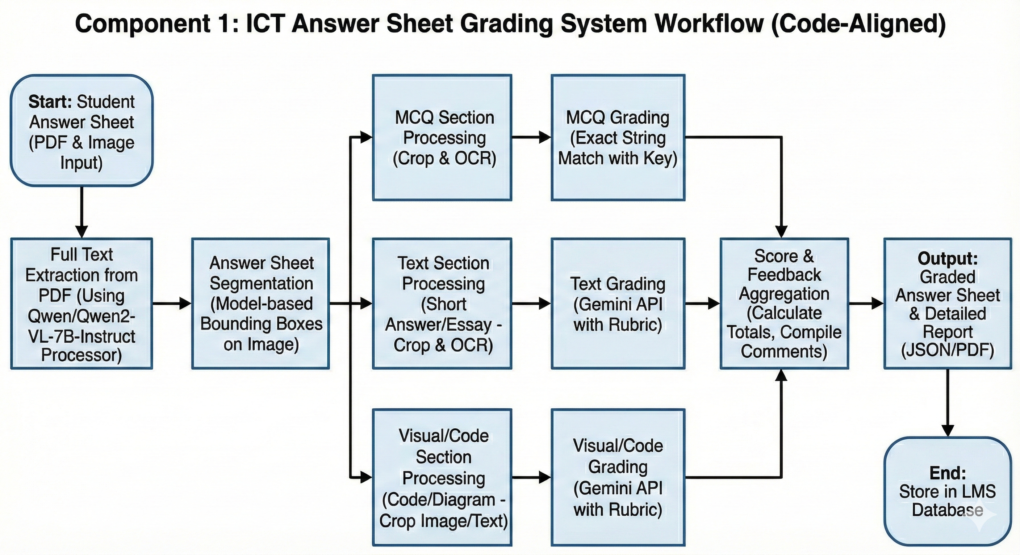
System Diagram
IT22243362 | Pathiraja P.U,M | 25-26J-162

Slide 15
IT22103154
M Wanniarachchi W.A.P
AI-POWERED TEACHER RETEACHING GUIDANCE AUTOMATION SYSTEM
BSc. (Hons) in Information Technology Specialization in Information Technology
IT22103154 | M Wanniarachchi W.A.P | 25-26J-162

Slide 16
Overall Reteaching Guide Flow
Student Exam Results Coming From the Component 1.
After the Concept Embeddings Create Knowledge Graph
GNN Mastery Prediction
BKT Learning Probability
Generate Editable Reteaching Recommendation For Teacher
Send Mini-lesson to Students for Self Learning.
IT22103154 | M Wanniarachchi W.A.P | 25-26J-162

Slide 17
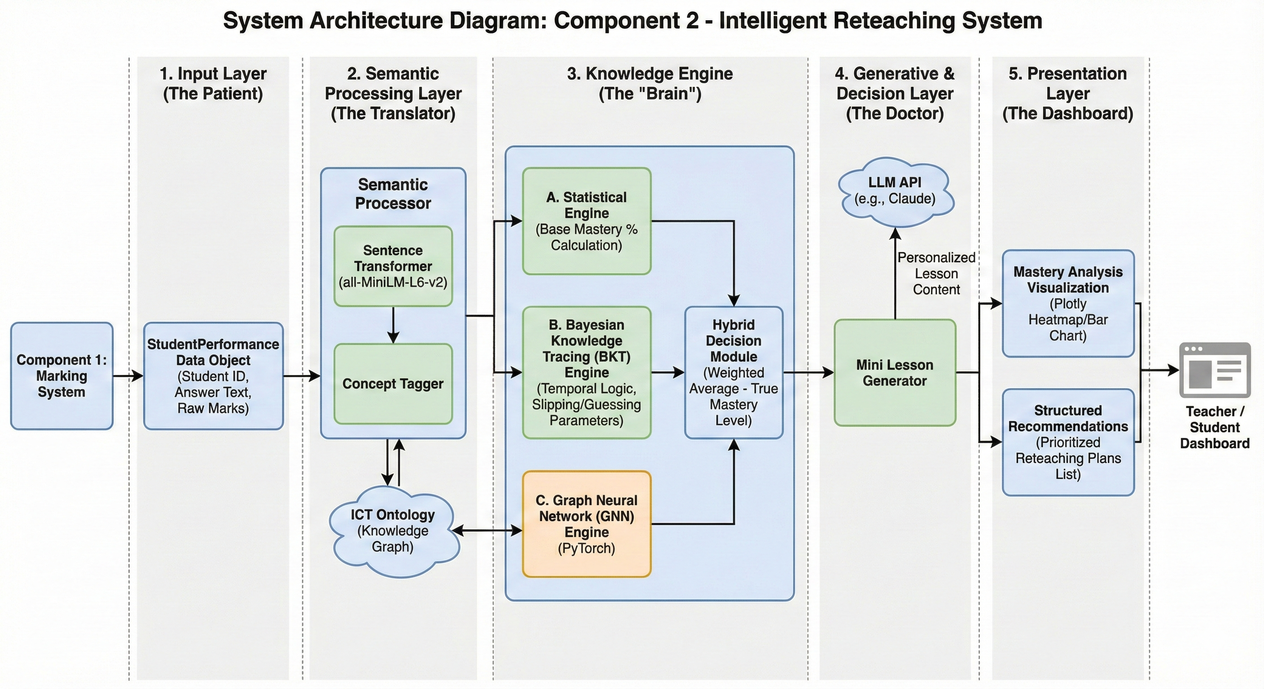
System Architecture Diagram
IT22103154 | M Wanniarachchi W.A.P | 25-26J-162

Slide 18
Functional & Non-Functional Requirements
Functional | Non-Functional
Analyze student marks and written answers. | High accuracy in topic identification.
Identify ICT topics related to each answer. | Fast processing for classroom use.
Calculate topic-wise performance percentages. | Reliable results across different exams.
Generate a list of weak topics for reteaching. | Secure handling of student assessment data.
Visualize results using charts.
IT22103154 | M Wanniarachchi W.A.P | 25-26J-162

Slide 19
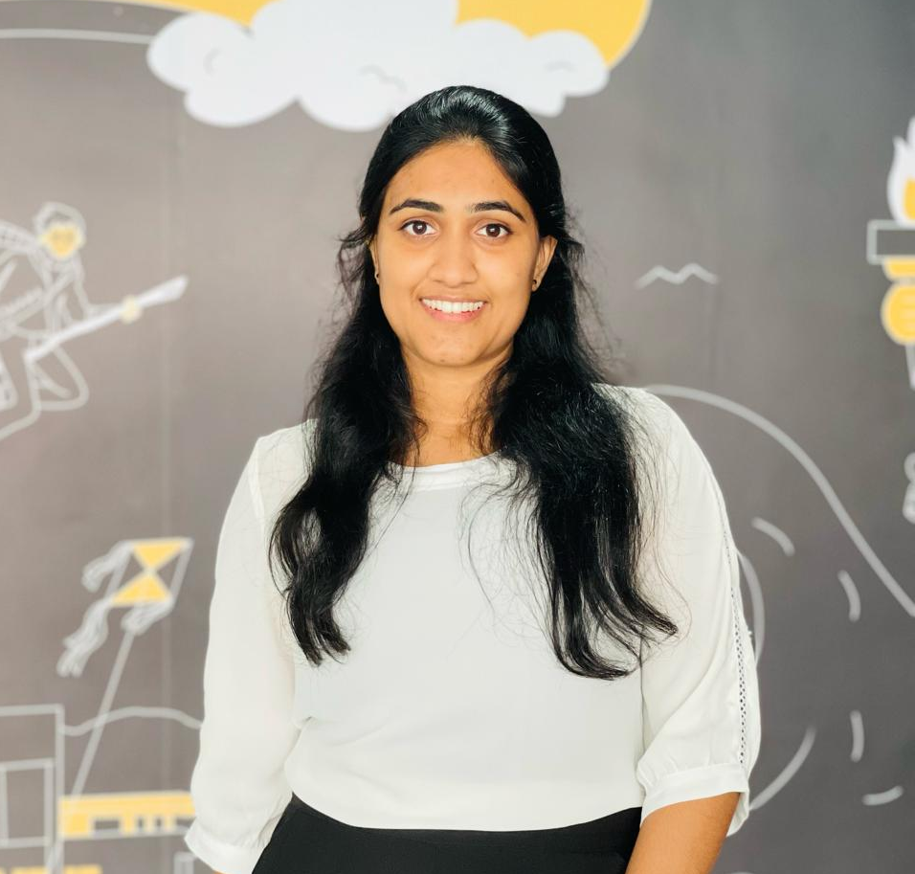
IT22120052
Hettiarachchi R.H
Automated Exam Question Paper Generation Engine.
BSc. (Hons) in Information Technology Specialization in Information Technology
IT22120052 | Hettiarachchi R.H | 25-26J-162

Slide 20
Component Overview
Automatically generates ICT exam papers for Grade 10 & 11.
Uses Machine Learning and Bloom’s Taxonomy to create balanced papers.
Teachers upload questions to a question bank.
System analyzes questions using the Sentence Transformer AI model.
Identifies difficulty level and Bloom’s cognitive level.
Ensures balanced difficulty and full syllabus coverage.
IT22120052 | Hettiarachchi R.H | 25-26J-162

Slide 21
System Process & Current Progress
System Workflow and Implementation
  Teacher selects Grade, Term, and Total Marks.
  System filters questions from the question bank.
  AI model analyzes the difficulty level of each question.
  Questions are balanced based on Bloom’s levels (Remember, Understand, Apply).
  The system generates a complete question paper automatically.
  Output includes MCQ and Essay questions with an answer key.
  The final paper is exported as a Word document ready for use.
Progress Update
  PP1: Implemented MCQ Question Generation.
  PP2: Implemented MCQ + Essay Question Generation.

Slide 22
Functional & Non-Functional Requirements
Functional | Non-Functional
Allow teachers to upload and manage MCQ questions | System should generate a question paper within a few seconds
Support Grade 10 & 11 ICT syllabus & Allow selection of Term (1 / 2 / 3) | Model should provide consistent and reliable Bloom classification
Automatically classify questions using Bloom’s Taxonomy | System should be easy to use for teachers with minimal technical knowledge
Export question paper as a Word (.docx) document | System should be scalable to support essay questions in future
Generate answer key automatically | Data should be secure and accessible only to authorized users
IT22120052 | Hettiarachchi R.H | 25-26J-162

Slide 23
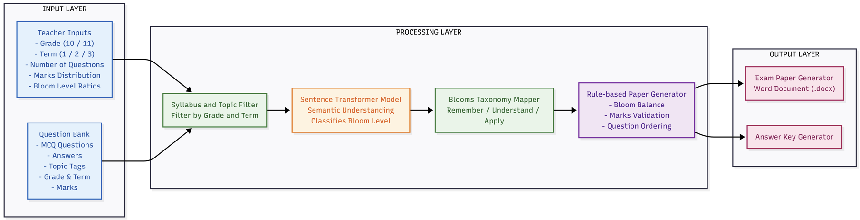
System Architecture Diagram

Slide 24
IT22095480
Jayasooriya L.T
AI Powered Personalized Learning Plan Generator
BSc. (Hons) in Information Technology Specialization in Information Technology
IT22095480 | Jayasooriya L.T | 25-26J-162

Slide 25
Overall Learning Plan Flow
Collect Student Performance Data from Components 1 & 2
Combine Teacher-Entered Assignment and Activity Marks
Analyze Student Performance Trends (Strong vs Weak Topics)
Identify Knowledge Gaps Using AI Analysis
Recommend Learning Resources (Articles, Videos, Practice Questions)
Generate Personalized Study Plan and Learning Path
Display Learning Plan in Student Mobile App Dashboard
IT22103154 | M Wanniarachchi W.A.P | 25-26J-162

Slide 26
Functional & Non-Functional Requirements
Functional Requirements | Non-Functional Requirements
Retrieve and aggregate data from Components 1, 2, and teacher inputs | High accuracy in weakness identification and resource matching
Analyze student performance across multiple assessment types | Fast mobile app performance
Identify weak and strong topics using AI-driven analysis | Scalable to handle multiple students simultaneously
Generate individualized learning plans per student | Secure data storage and user authentication
Display term-wise performance reports and visualizations | Usability for target audience
Recommend relevant online resources (videos, articles, exercises) | Reliability of data synchronization
IT22095480| Jayasooriya L.T| 25-26J-162

Slide 27
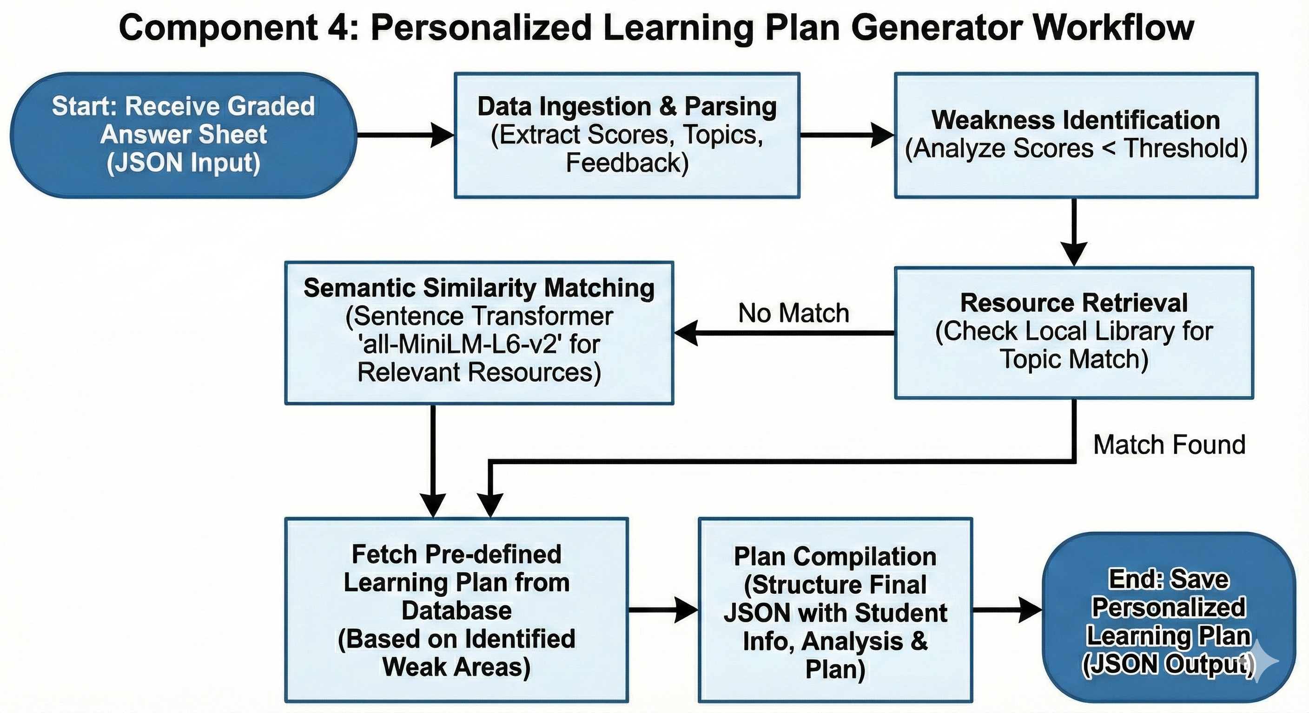
System Diagram
IT22095480| Jayasooriya L.T | 25-26J-162

Slide 28
Performance Benchmarks
Results &
Testimonials
TeachMate AI · Grade 11 ICT
15 students · One Academic Term
84.9%
Grading Time Reduced
Teacher Feedback (Likert 1–5) – Mr. Kaveen Abeshinhe
0.83
F1-Score (Gap Prediction)
4.5/5.0
4.2/5.0
3.9/5.0
86%
Bloom's Classification
Language Clarity
Relevance
Constructiveness
72% of students following reteaching recommendations progressed from 'Needs Improvement' → 'Proficient' | t(118) = 3.42, p < 0.001, Cohen's d = 0.63
14.4%
Learning Outcome Gain

Slide 29








Limitations of the System & Future Improvements
Limitations
Future Improvements
OCR Accuracy
Multilingual Support
5–10% of answer sheets with highly inconsistent handwriting require manual review
Extend OCR, NLP models, and resource database to Sinhala & Tamil
Language Gap
Offline-Capable App
Limited quality Sinhala/Tamil learning resources in the recommendation database
Progressive web app with local caching; auto-sync when connectivity restores
Connectivity Dependency
Expanded Assessment
Most core features require active internet; students in rural areas face reliability gaps
Add diagram annotation & code evaluation for O/L programming components
Pilot Scope
Longitudinal Study
One term · 2 Western Province schools · 6 teachers — limits broader generalizability
Multi-year evaluation + federated learning across schools for stronger models
TeachMate AI · SLIIT Faculty of Computing · Supervisors: Samantha Rajapaksha & Bhagyanie Chathurika

Slide 30
Thanks!
Do you have any questions?

